Slide 1
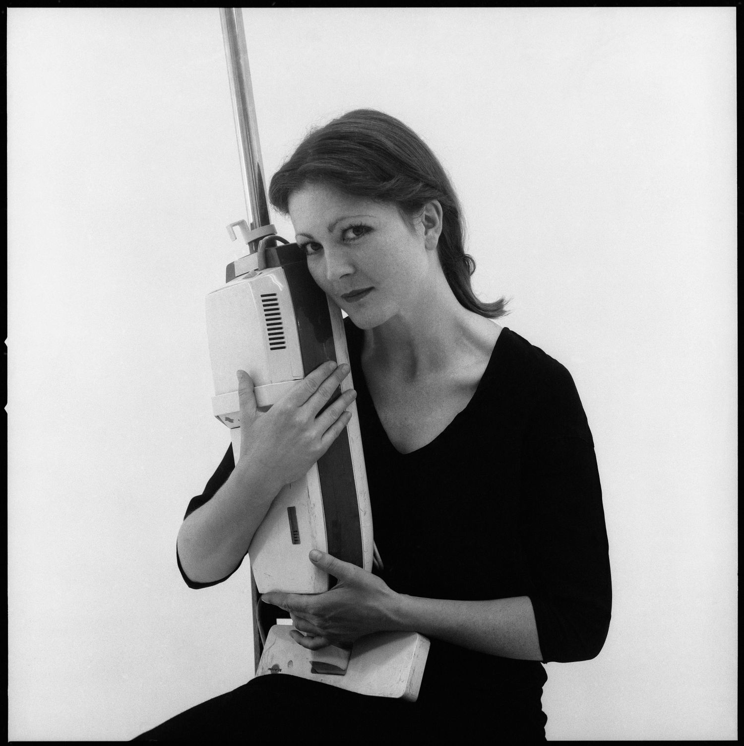
Feminist Art Explorer: Visual Themes
in 1970s-80s Art
Student Name: Veronika Heckl

Slide 2
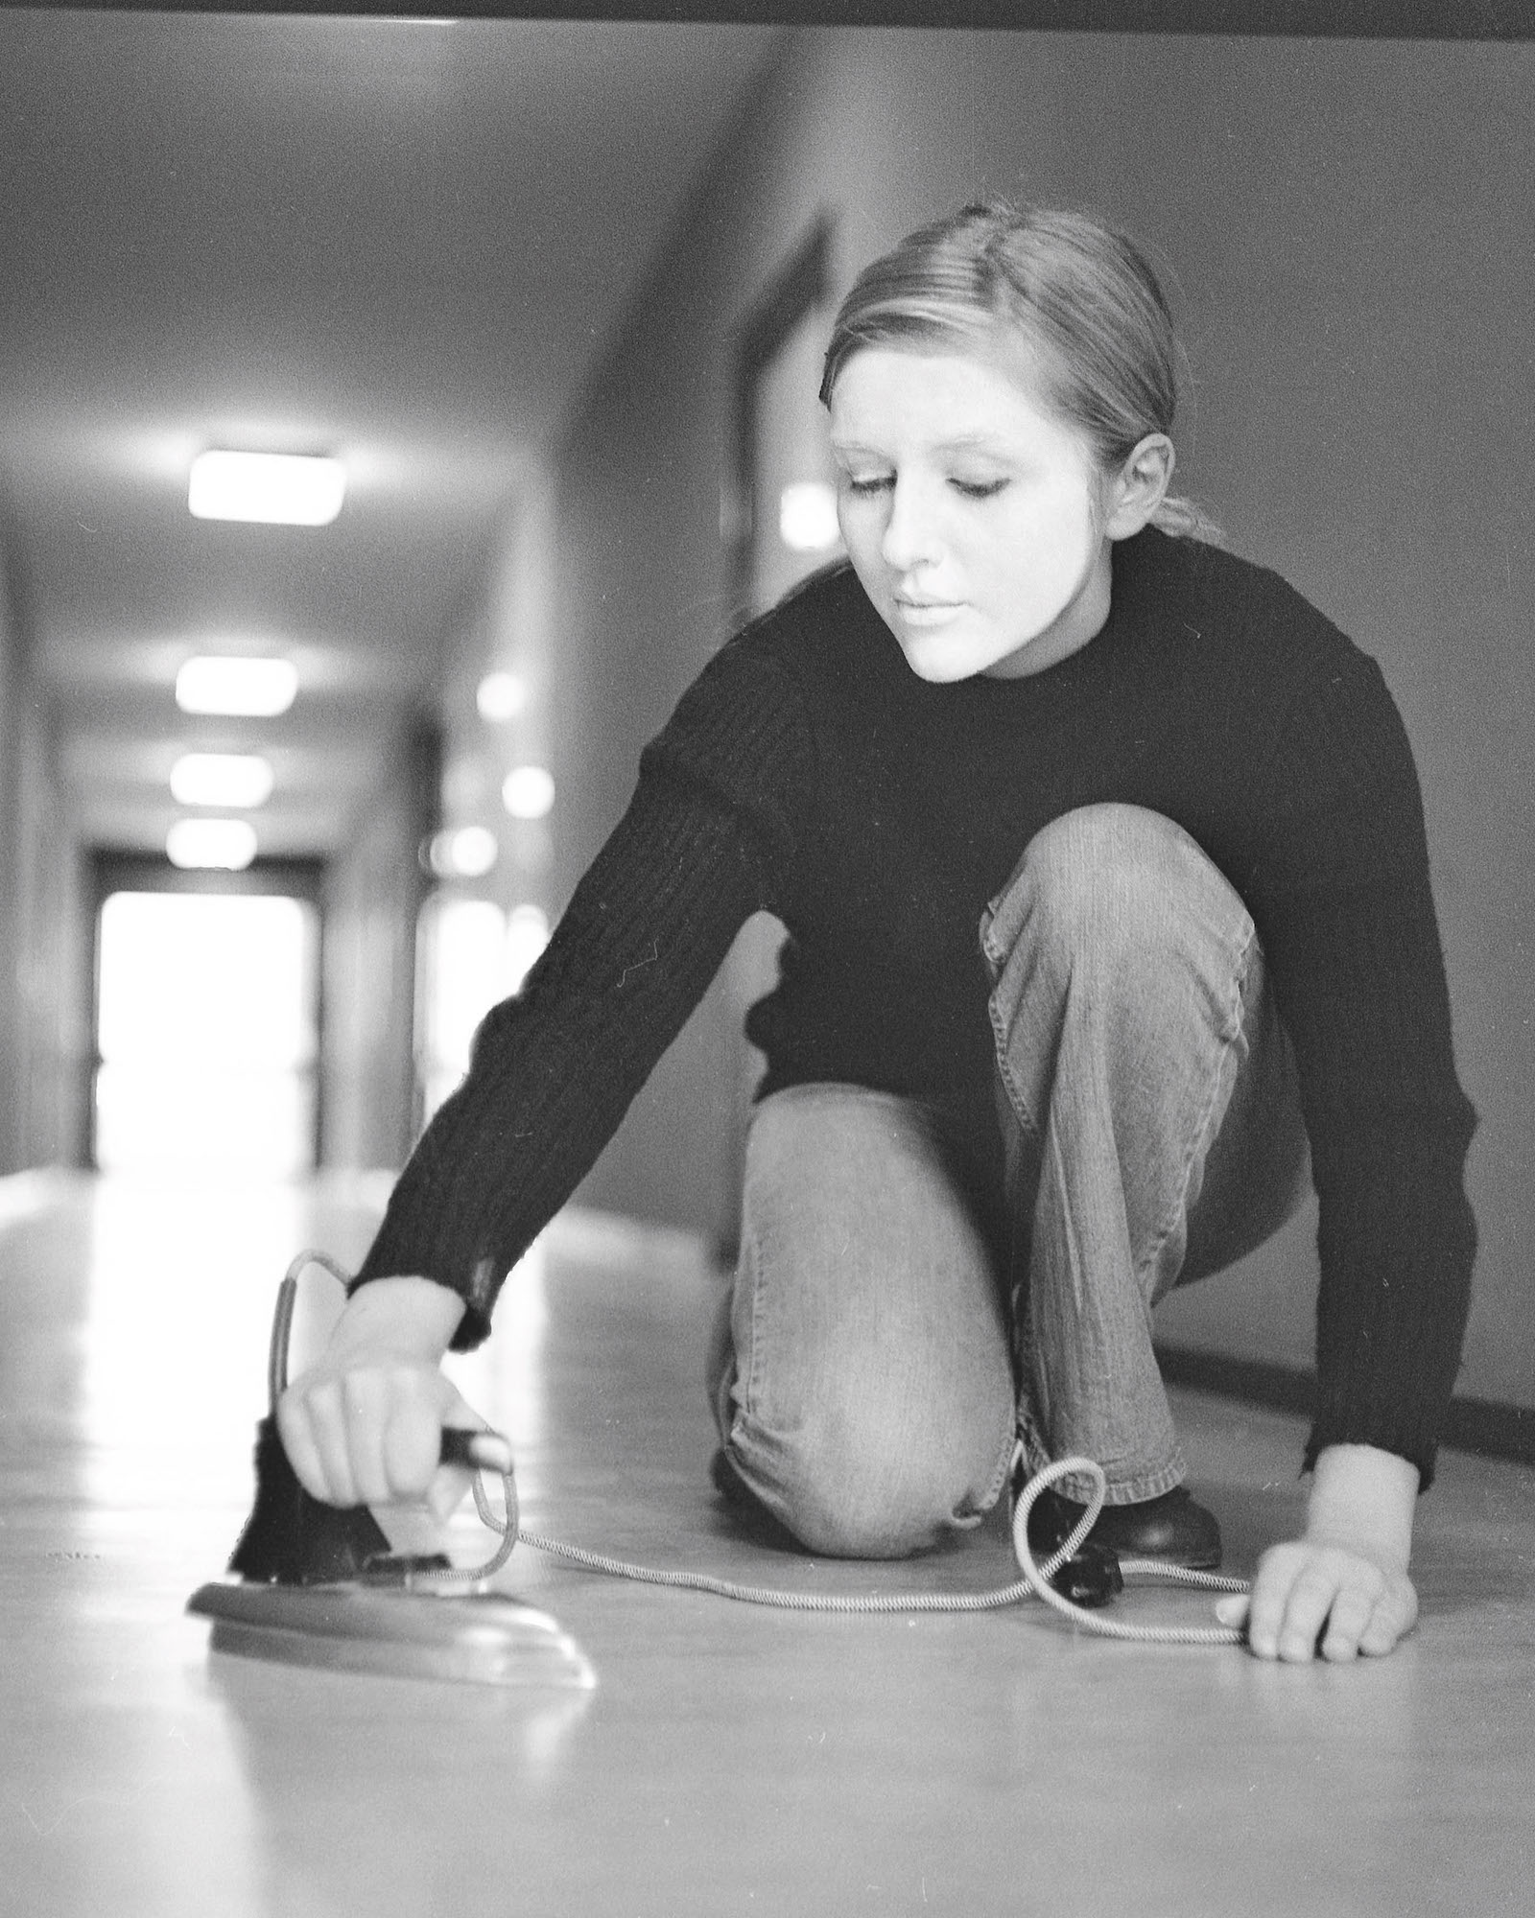
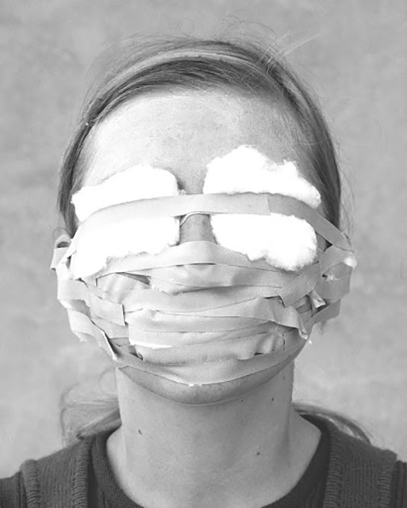
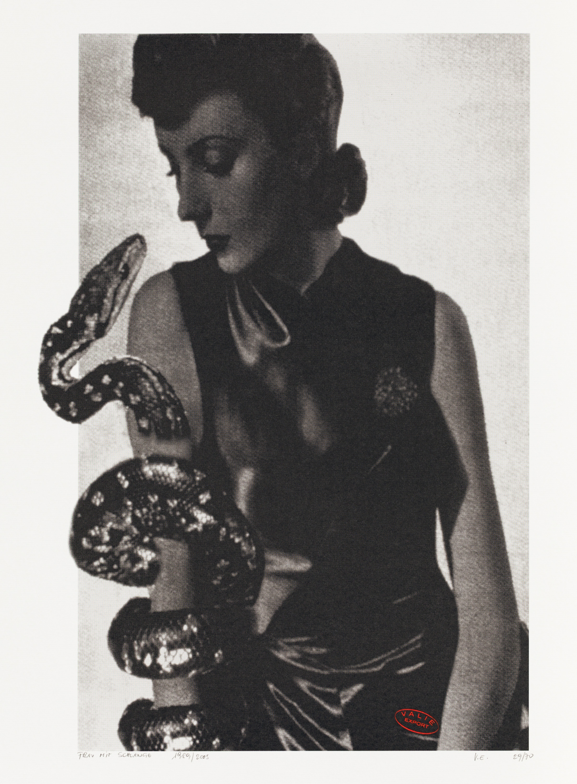
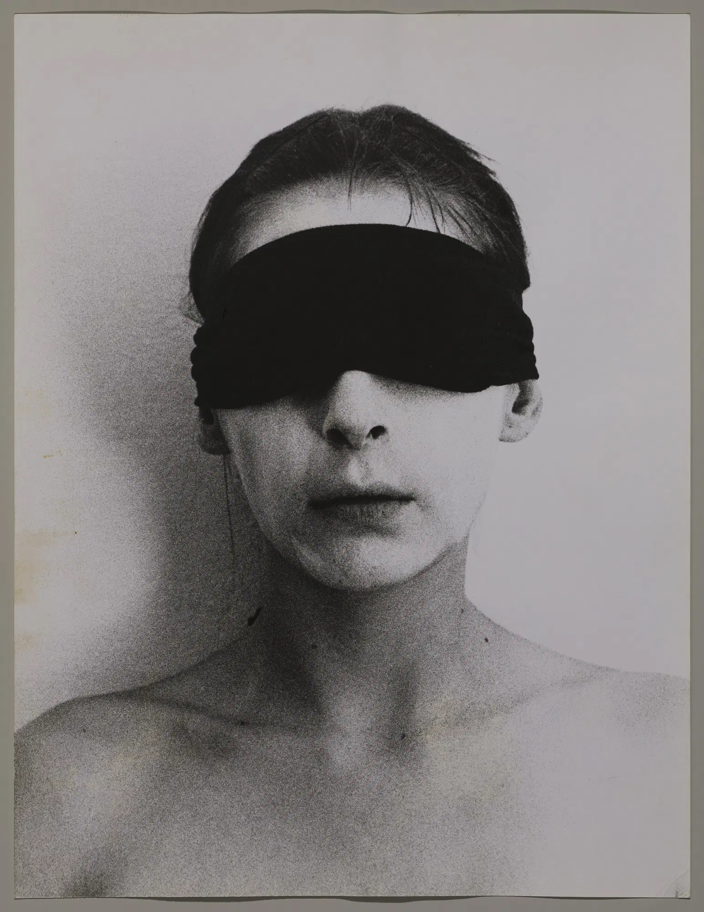
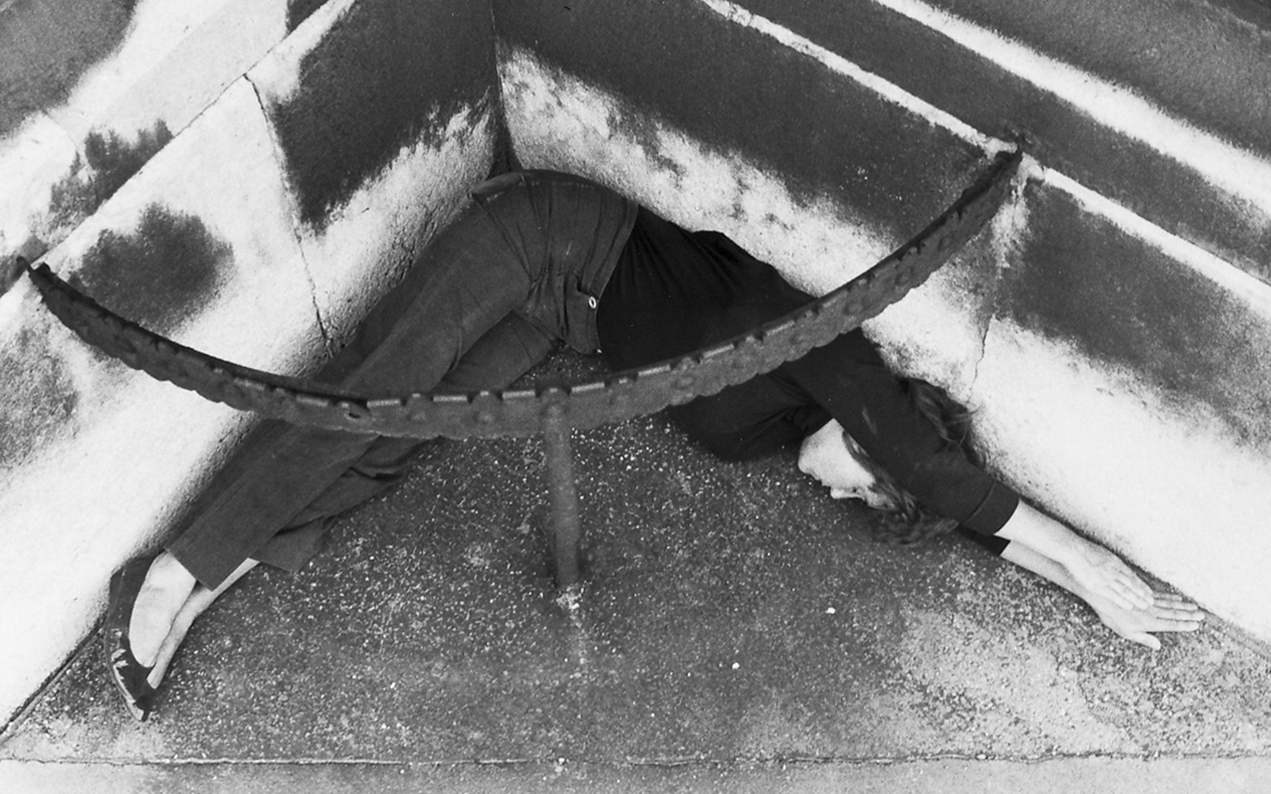
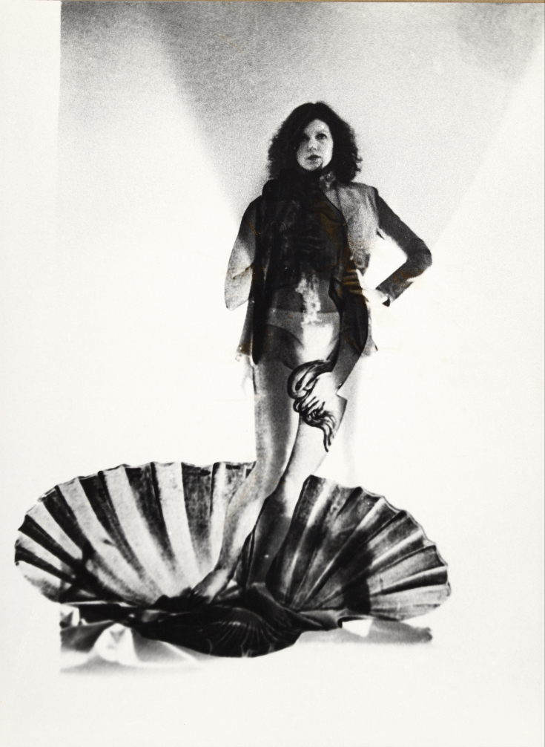
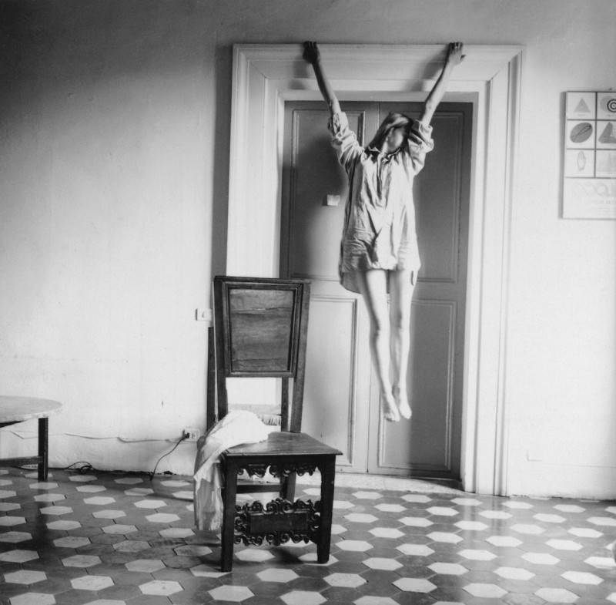

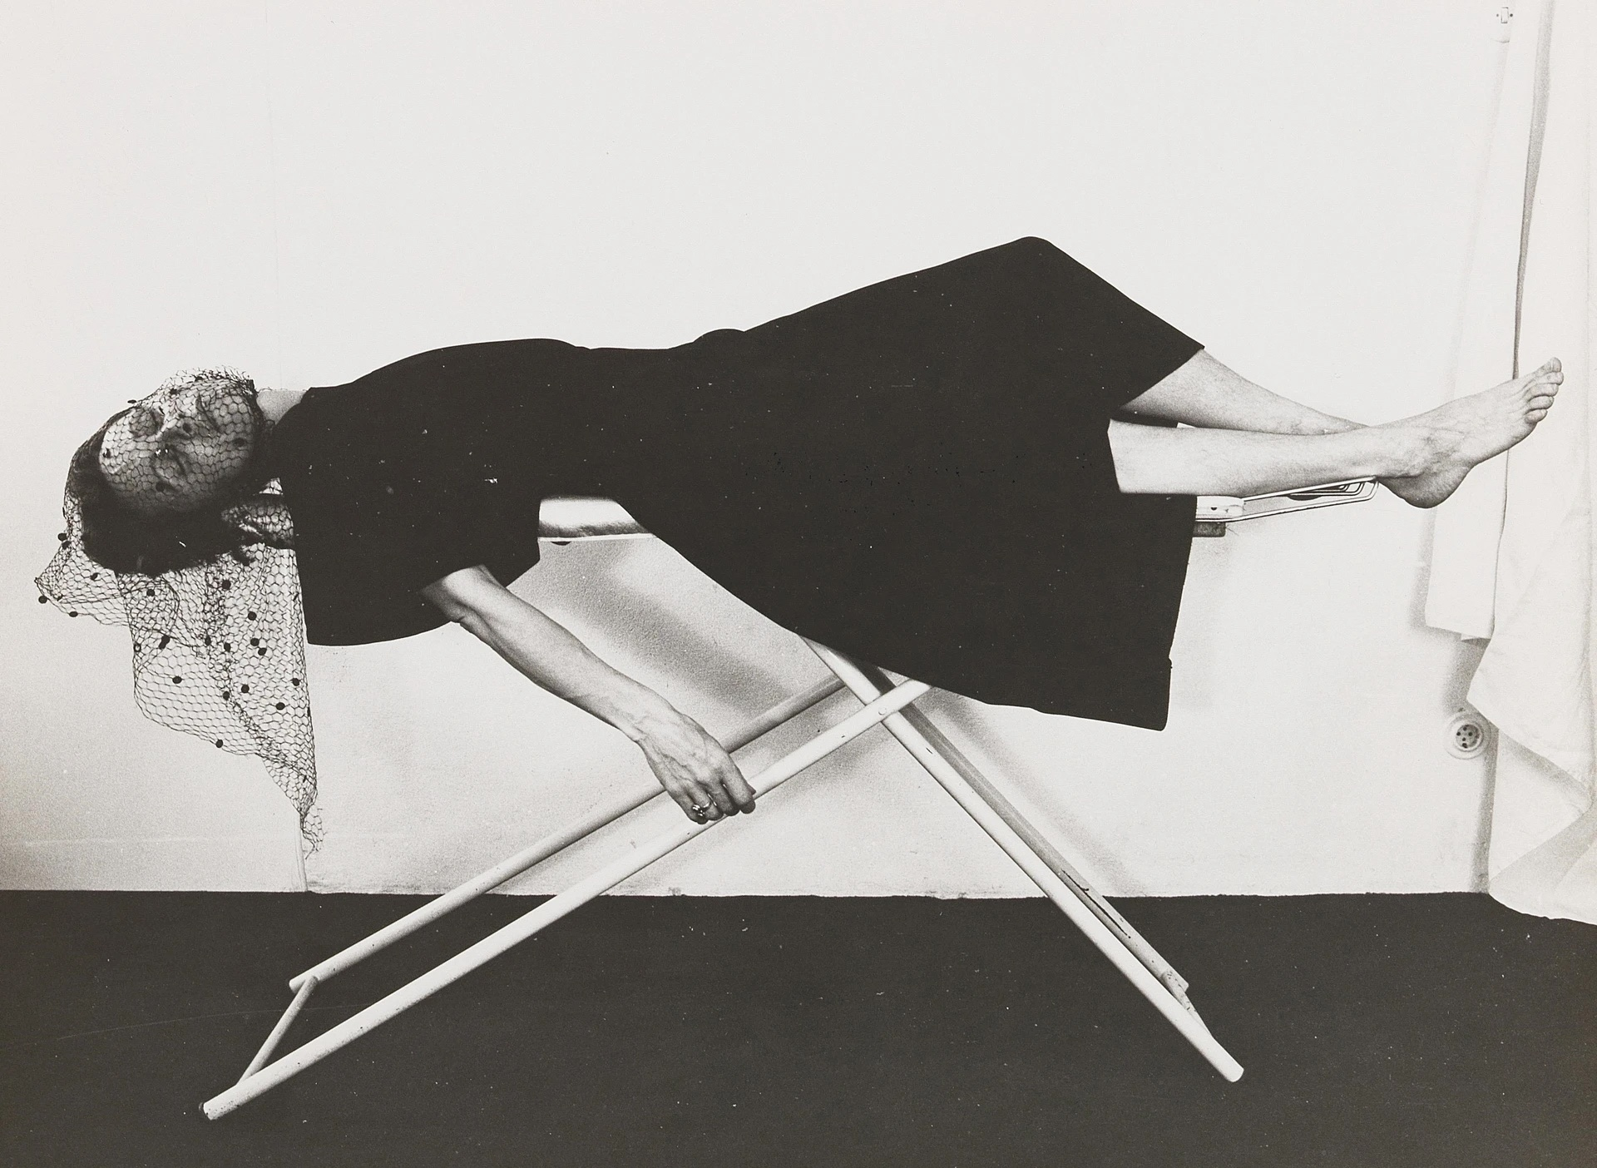
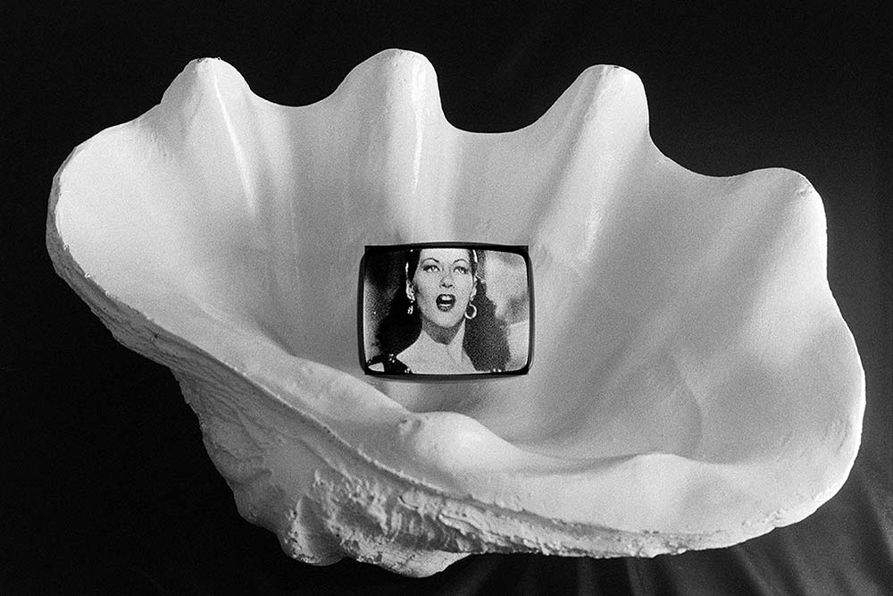

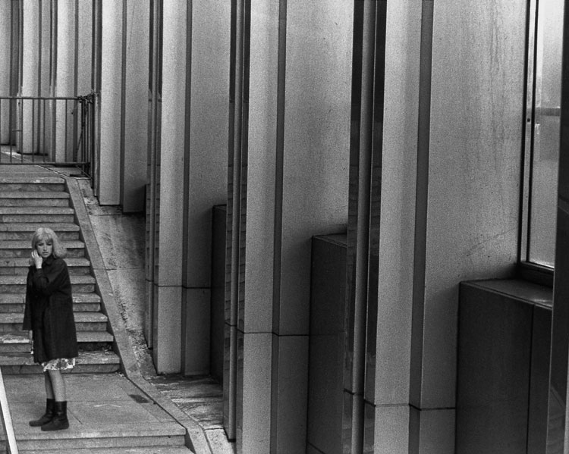
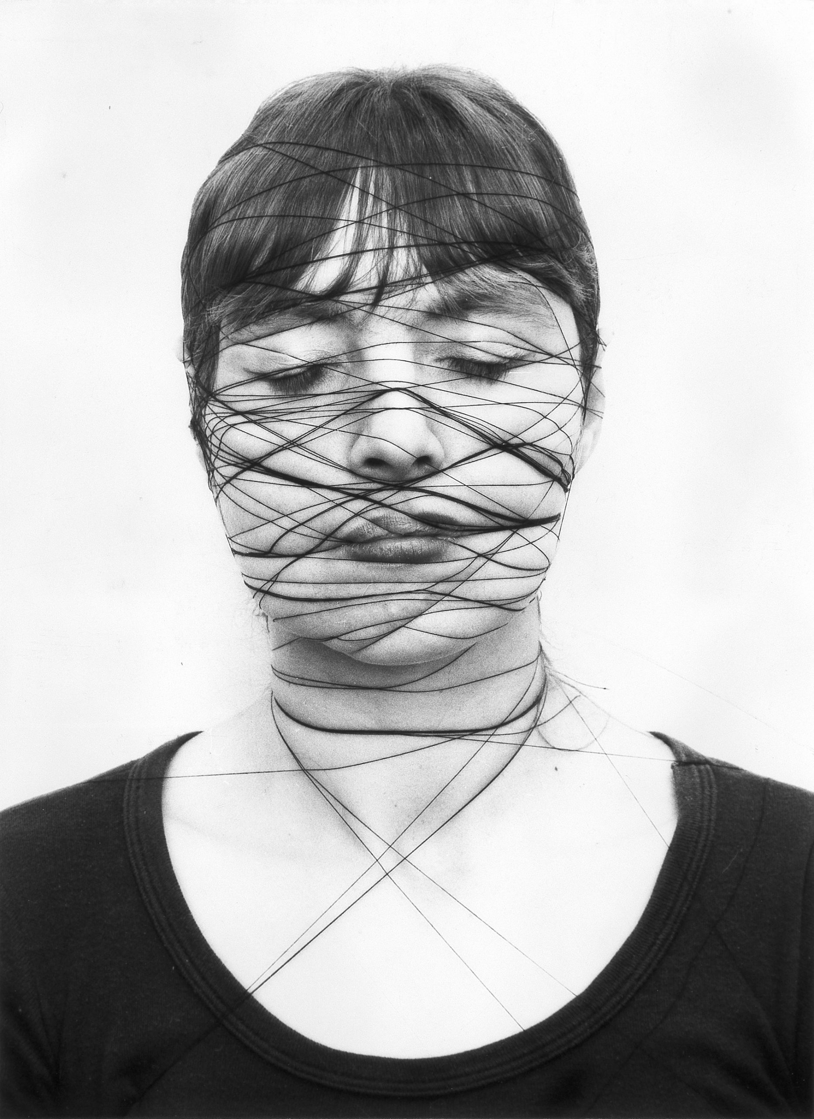

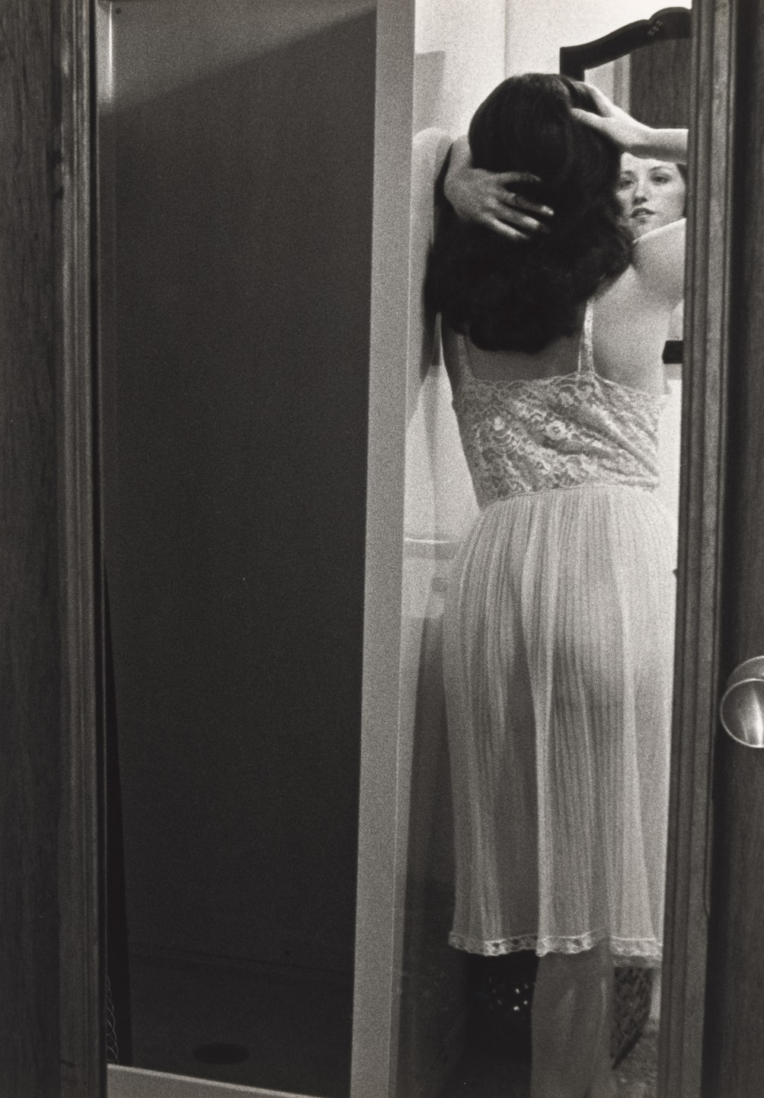
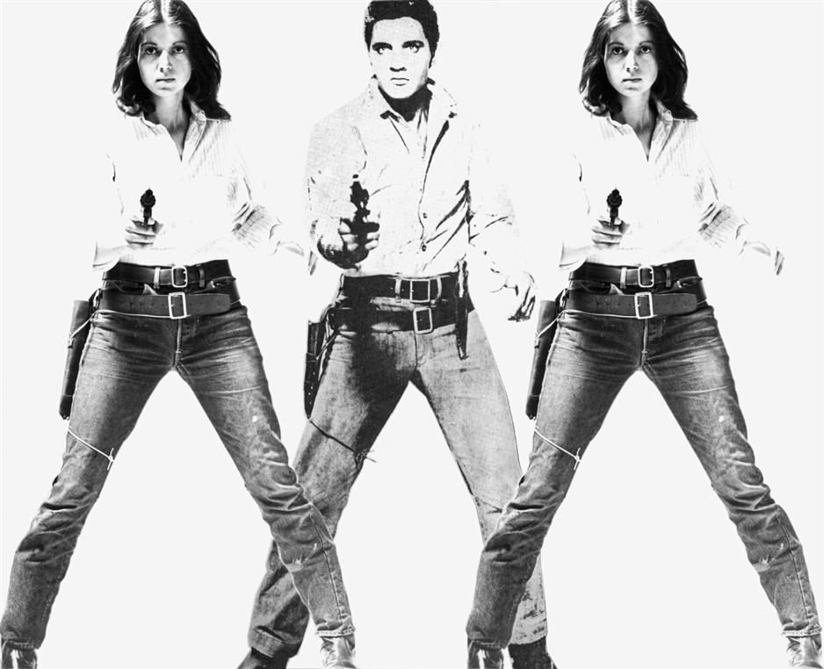
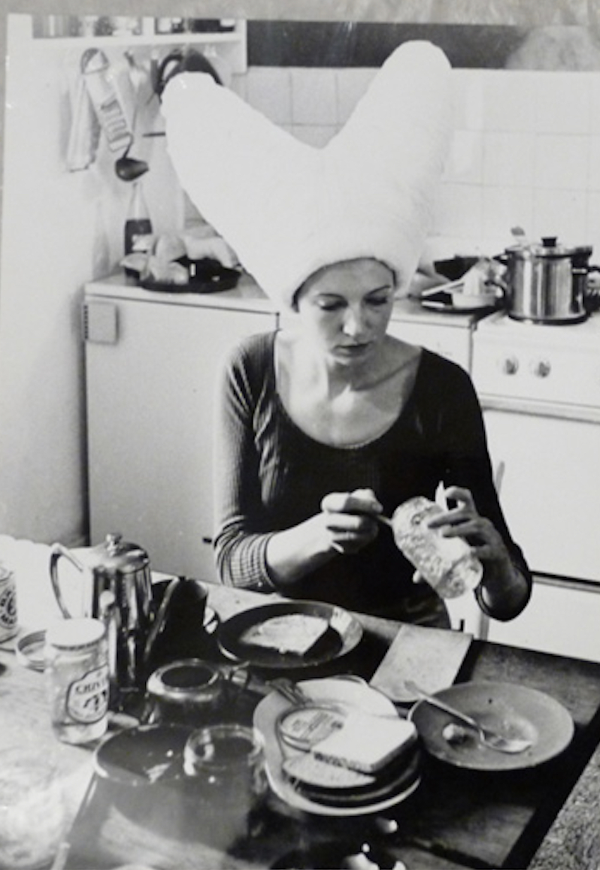
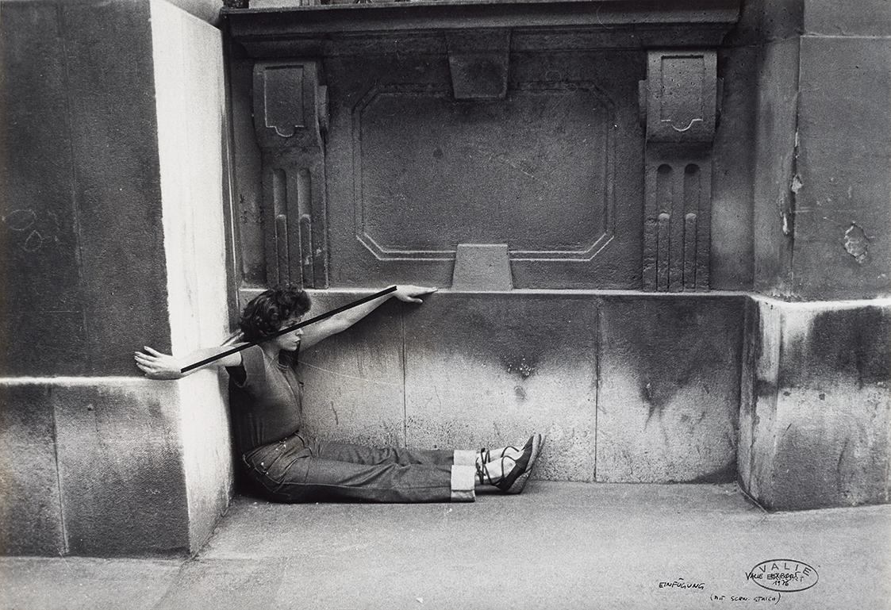
1. Project Proposal: Objectives & Relevance
Project Goal
Why It Matters
An AI-powered tool to uncover visual patterns in 1970s and 1980s feminist art.
Reveals how women artists used shared symbols to challenge stereotypes Learning aspect -> chat with a bot that’s instructed to
talk about feminist art.
Creating a base for comparing the symbolism from
artists of different countries f.e. Austria VS USA

Slide 3
2. Literature Review
“The feminist artists of the 1970s systematically challenged visual representations of women by using their own bodies as mediums—disrupting the male gaze and redefining female subjectivity through photography, performance, and film.” (Schor, 2020)
Key Insights:
-> Feminist artists of the 1970s used fragmented bodies, domestic symbols, and performative gestures to subvert traditional visual norms.
-> These recurring motifs form a rich, visual vocabulary—ideal for AI pattern detection (e.g., clustering by pose or symbolism).
-> My project reflects Schor’s thesis: feminist art is not isolated, but part of a shared thematic language, now made visible through computational analysis.

Slide 4
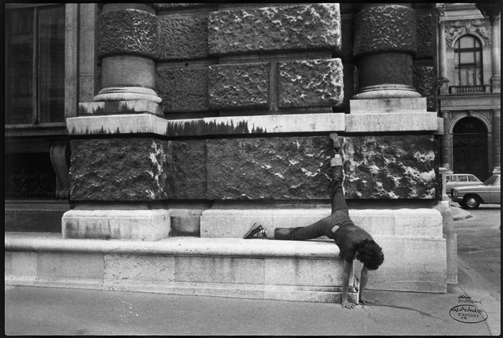
3. Data Collection: Type & Processing
A. Image & Metadata Sources
A dataset of 30 feminist artworks
metadata.csv that includes metadata: artist, title, year, nationality which is mapped to each image
Each image is processed through a CLIP model to generate visual-semantic embeddings.

Slide 5
4. Model Development
Model and unique Aspects
GPT-4o multimodal analysis with custom Chain-of-Thought prompting that forces step-by-step cultural comparison:
1. Observe visual elements → 2. Cross-cultural comparison → 3. Separate cultural vs. universal themes → 4. Identify shared feminist strategies
5. Evaluation
Primary Metric:
Qualitative expert validation of AI-generated comparative analyses (accuracy in identifying genuine cross-cultural visual parallels vs. cultural stereotypes).

Slide 6
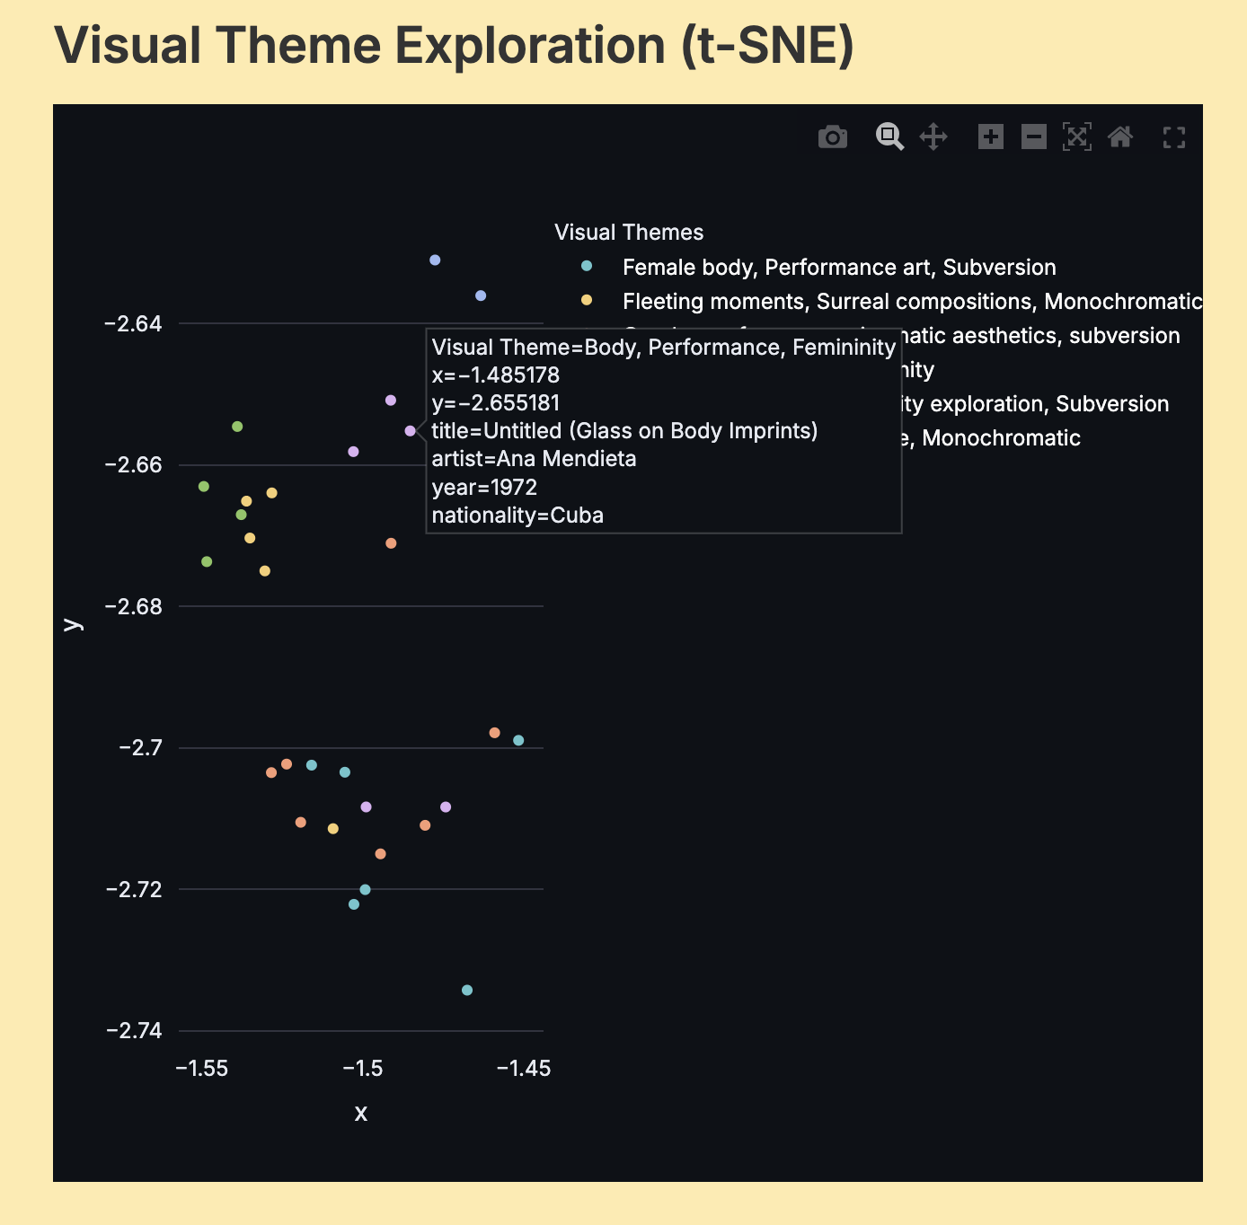
6. Creative Output
Thematic Cluster Explorer:
Interactive visualization showing how “Body, Performance, Feminitiy" theme appears in Cuban (Ana Mendieta) and American (Janice Guy) and German (Annegret Soltau) feminist photography despite cultural differences.

Slide 7
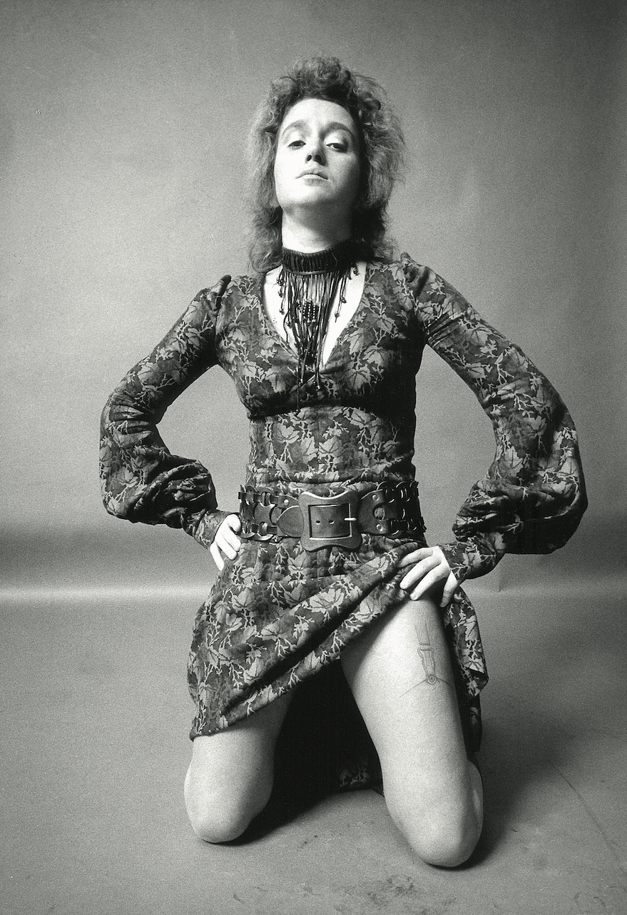

Reflection & Conclusion
Ethical Consideration
Monitored AI to prevent "flattening" feminist messages (e.g., protest art described as "decorative"). Implemented prompt engineering safeguards against national stereotyping (e.g., "Avoid deterministic links between nationality and style").
Model Bias – risk of dominant western, male lens
Misinformation – Chatbot

Slide 8
This project (maybe) demonstrates how AI can reveal previously overlooked transnational visual dialogues in feminist art history, enriching our understanding of global feminist movements.

